Slide 1
Micro Focus Collaboration:
Enterprise Messaging, GroupWise и не только
Иван Левшин
26.02.18
Notes:
1

Slide 2
Micro Focus Vision

Slide 3

Our Vision
Мы предоставляем заказчикам лучший в своем классе набор приложений корпоративного уровня со встроенными аналитическими средствами
Заказчики получают лучшие из наших инноваций, мы производим высококачественные продукты, которыми гордимся
Notes:
1

Slide 4



Our Portfolio
Micro Focus is uniquely positioned to address customers’ needs across:
DevOps
Hybrid IT
Security & Risk Management
Predictive Analytics
Notes:
1

Slide 5



Everything we do is based on a simple idea–
Notes:
1

Slide 6

Everything we do is based on a simple idea–
the fastest way to get results from new technology…
Notes:
1

Slide 7

Everything we do is based on a simple idea–
the fastest way to get results from new technology is to build on what you have.
Notes:
1

Slide 8

Everything we do is based on a simple idea–
the fastest way to get results from new technology is to build on what you have.
In essence, bridging the old and the new.
Notes:
1

Slide 9
The Collaboration Space

Slide 10








66
Minutes per day
Collaboration is anything but passé
Email is alive and well
29
Minutes per day
192
Minutes per
day
109
Minutes per day
Notes:
Despite the rise of social media, research in the United States shows that information workers still spend significantly more time using email than these newer forms of communication. The trend is similar in other parts of the world. Wherever you go, it seems that email is still the chief way that many users collaborate with one another on projects and documents both inside and outside their organizations.
A recent survey by Reuters found that the average U.S. white collar worker spends 192 minutes per day (in and out of work) engaging with business email– or about 3.2 hours per day!
(http://www.huffingtonpost.com/entry/check-work-email-hours-survey_us_55ddd168e4b0a40aa3ace672)
Osterman Research found that the time spent in email dwarfs time spent using other communication tools, such as the telephone (66 minutes per day) and instant messaging or other real-time communications (29 minutes).
The use of social media varies depending on the age of the worker, but Global Web Index estimates that on average, each internet user spends about 109 minutes per day on social media– in and out of work.
(http://www.globalwebindex.net/blog/daily-time-spent-on-social-networks-rises-to-1-72-hours )
The bottom line is that while social media, real-time communications, web conferencing, and collaboration tools are all very useful, they are primarily complements to the use of email, not substitutes for it.
1

Slide 11
Email Is Still King
Email still the most preferred form of communication
Cloud-based, enterprise email is being adopted more slowly than predicted
58%
13%
of managers said email is their preferred form of enterprise communication
(face-to-face was a distant second at 23%).
enterprise penetration
in 2016
[SOURCE: Radicati Group]
[SOURCE: Gartner Research]
Notes:
1
1
11
In fact, 58% of managers in a Radicati Group study said email is their preferred form of enterprise communication. And traditional, on-premises email still represents the lion’s share of deployments—and will far into the future. While cloud-based email is clearly here to stay, Gartner’s latest figures show that cloud-based email is only 13% of the enterprise market as of 2016, with the remaining 87% being on-premises, hybrid, hosted or private-cloud based solutions.
The bottom line is that while the cloud may be suitable for many organizations, others--particularly those with strict compliance requirements or data protection directives--find that on-premises email solutions are the only way to keep sensitive data strictly within their control. These organizations will look for on-premises solutions that offer the low administrative burden and TCO promised (but not often delivered) by the cloud, but the equally critical ability to maintain control of their data--and prove it in audit.

Slide 12
Current Market Trends
Collaboration
Hosted Email / Cloud
Enterprises are increasingly adopting hosted email platforms and cloud SaaS to reduce infrastructure and management costs
Enterprise Social Collaboration
Enterprise social collaboration helps teams interact and share messages, files and communication history
Email Security
Increasing demand around email security including encrypted, signed, inbound/outbound and focus on data leakage via emails
Anywhere Access
Business today expect to be able to reach their email from multiple devices, at any time, from any location

Slide 13





















Micro Focus Collaboration
Communication
Collaboration
Secure
Cost
Effective
IT Control
Internal
58% of managers say email is their preferred form of enterprise communication.
Email
Calendar
Social
96% of execs cite the lack of collaboration or ineffective communication as the source of workplace failure.
External
Desktop
Mobile
Notes:
Given today’s world of constant communication, you face some pressing challenges. You need to:
keep your email system secure, cost effective and firmly within IT’s control.
You also need to deliver robust, secure email, calendaring and social business to today’s desktop platforms and mobile devices.
However– today’s distributed workforce, extended partnerships, and social business world means traditional communication needs social collaboration too.
It’s interesting to note that 96% of executives cite the lack of collaboration or ineffective communication as the source of workplace failure. It’s easy to see why many organizations are looking for ways to collaborate, share files and ideas, manage projects and communicate effectively as teams, both internally and externally.
http://news.videonor.com/12-statistics-that-will-change-the-way-you-view-team-collaboration

Slide 14
Announcing – Enterprise Messaging
1
Notes:
We are excited to announce the all new product Enterprise Messaging!
1

Slide 15





Enterprise Messaging
1
Notes:
Micro Focus Enterprise Messaging is a complete collaboration solution that provides:
Email, Calendaring, Scheduling, Task Management
Complete Archiving
Unparalleled Security
Chat-based teamwork
Disaster recovery
Available on-premises or in the cloud
1

Slide 16
Secure Collaboration
Email
Instant messaging
Scheduling
Contact management
Task management
All with mobile synchronization
1
Notes:
1

Slide 17
Complete & Compliant Archiving
Email archiving
Search tools
eDiscovery tools
Can be expanded to include social media and mobile archiving
1
Notes:
1

Slide 18
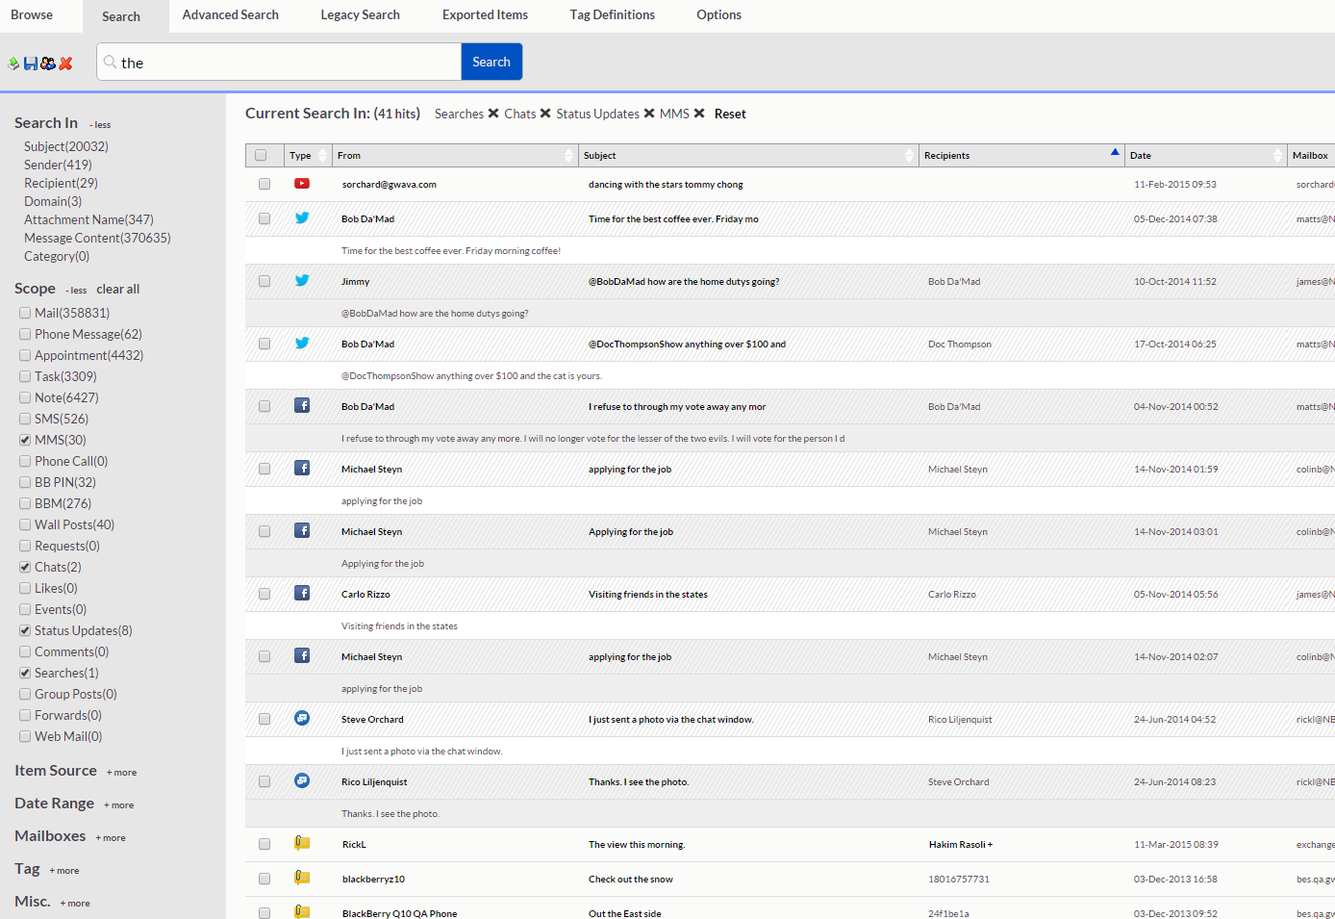
Enterprise Messaging Archiving: Manage communication data and ensure regulatory compliance
The concerns
Regulation compliance
Growing data volumes and cost
eDiscovery & litigation preparation
Data sovereignty
Risks with new forms of communication – social media/mobile
The solution
Enterprise Messaging Archiving
Complete and compliant archive
Archive your messages, files, attachments, and appointments into a single archive
Manage communication data
Built-in eDiscovery
On-prem or geo strategic cloud (meets data sovereignty requirements)
Can be expanded to a unified archive of email, social media, and mobile communication data
1

Slide 19

Unparalleled Security
Inbound & outbound protection
Anti-virus
Anti-spam
Cybercrime protection
DDoS protection,
Protection for the MTA, POA, WebAccess, and Mobility
1
Notes:
1

Slide 20
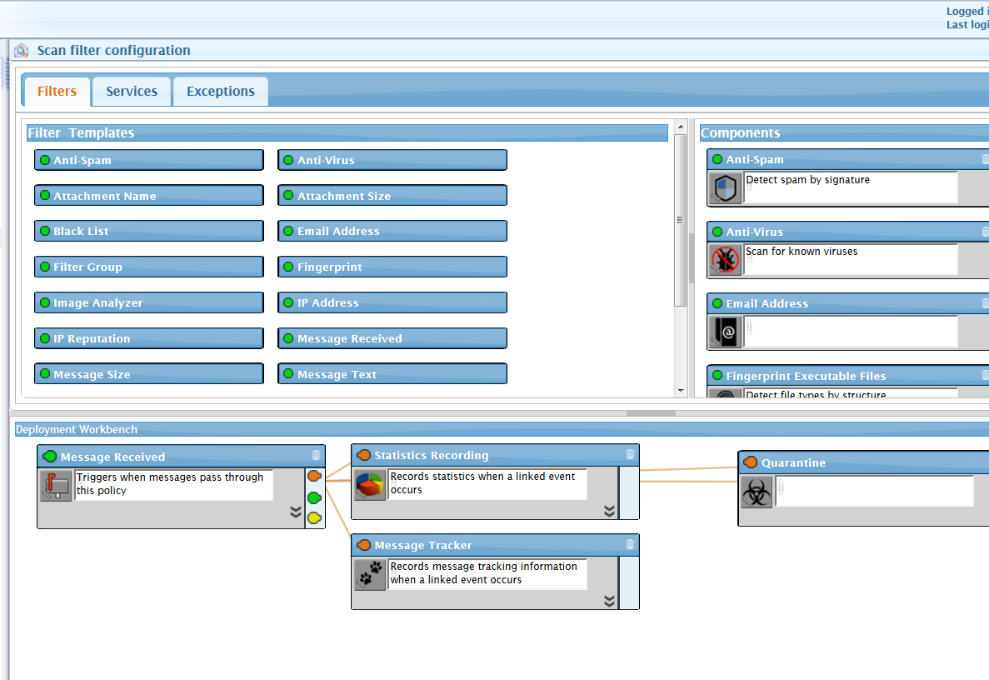
Enterprise Messaging Security: Solves Major Email Security Concerns
The concerns
Shift from spam and viruses (which is still a huge concern)
Botnet attacks, phishing, ransomware, spoofing
Threats continue to evolve, meaning that a new threat could emerge at anytime
The end point is the target
The solution
Enterprise Messaging Security
Inbound & outbound protection, perimeter defense scanning
Anti-virus, Anti-spam, cybercrime protection
DDoS protection, illicit image blocking
Complete system protection for the MTA, POA, WebAccess, and Mobility
1

Slide 21
Chat-based Teamwork
Communicate in real time through chat, share files, and track all changes on projects—all from one interface
1
Notes:
1

Slide 22

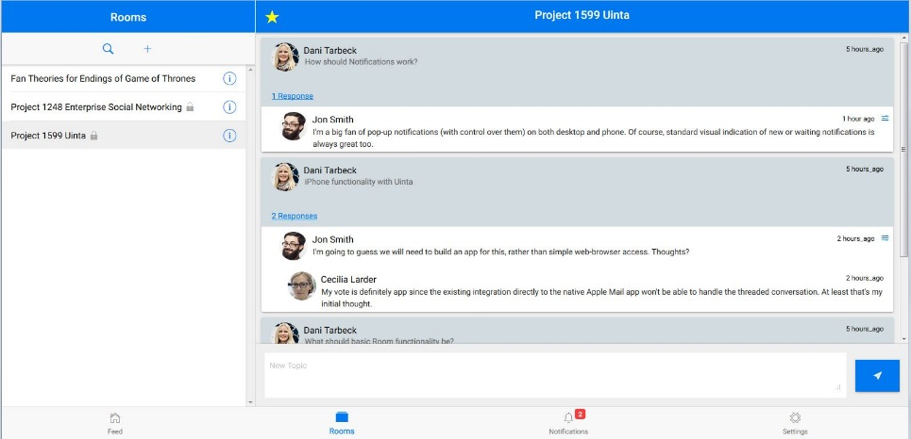

GroupWise TeamWorks
Chat-based workspaces for enhanced productivity
Chat-based Teamwork
  Topic-driven, project-oriented,
  team-driven conversations
Works with GroupWise email
  Enhances team collaboration without
  having to sacrifice traditional email
  Access through desktop client
Web & Mobile Access
  Mobile access through Apps
  (iOS and Android)
Only available in
Micro Focus
Enterprise Messaging

Slide 23
Disaster Recovery
Immediate backup and failover to ensure Enterprise Messaging is always available
1
Notes:
1

Slide 24
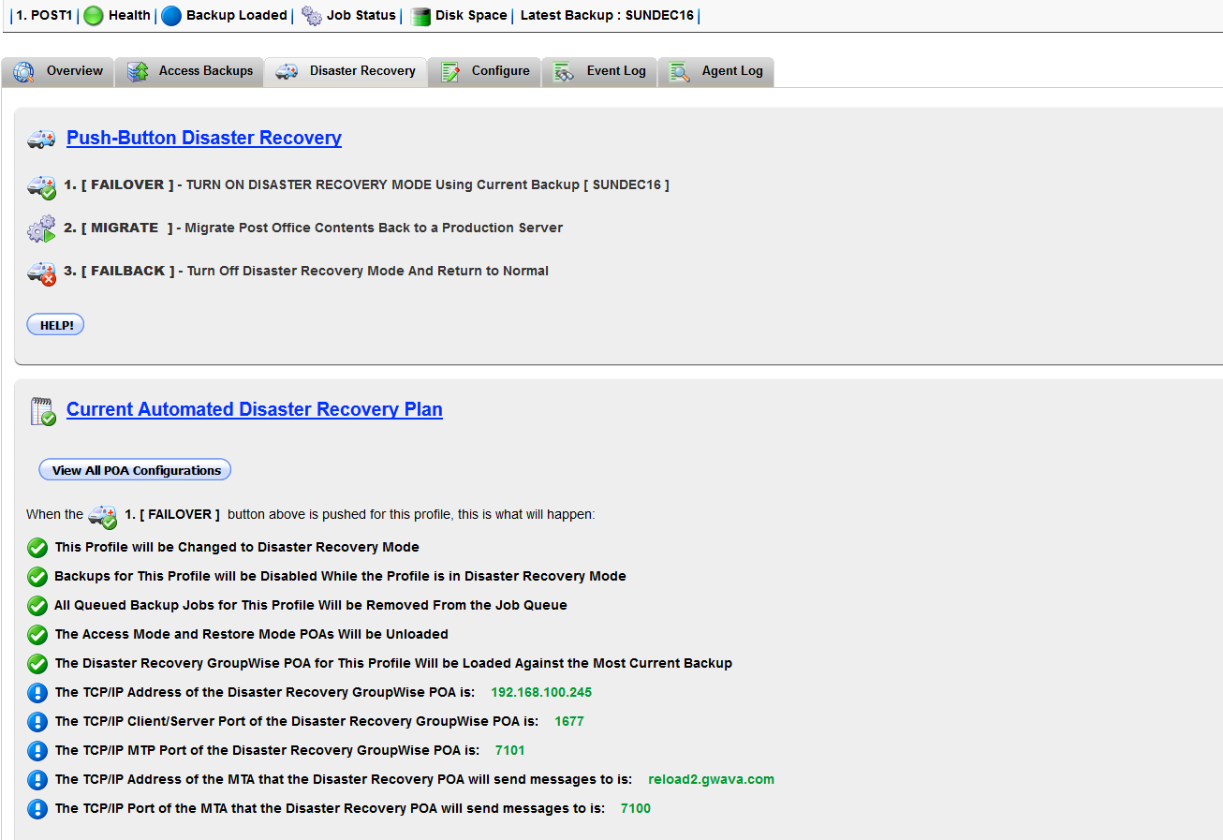
Disaster Recovery & Backup: Ensure System Availabilty
The concerns
Email failure can costs companies millions is downtime and lost productivity
Most backup solutions cannot provide a failover if the email system goes down
The solution
Enterprise Messaging Disaster Recovery
Hot Backups
Immediate Recovery & Full Restoration
Messaging System Failover
Never experience downtime of your Enterprise Messaging System
1
Notes:
Other backups are just a snapshot in time. GroupWise DR is full backup and failover solution for GroupWise. It is called the “Holy Grail of GroupWise” because you will never have to worry about your GroupWise system ever going down again.
With hot backups of the GroupWise system, GroupWise Disaster Recovery allows for immediate recovery and full restoration of all or any portion of your mail system—a domain, a mailbox, or a single email
1

Slide 25



Additional Capabilities
Monitoring
Reporting
Mailbox management
Auditing and oversight
1
Notes:
1

Slide 26
Your Choice of Deployment
On-premises
Hosted in the cloud
1
Notes:
1

Slide 27



Enterprise Messaging
Available by the end of the year
1
Notes:
1

Slide 28
Your IT World Today

Slide 29

Data Security and Governance
Notes:
Regulatory restrictions and data protection directives are here to stay. And because email is often the conduit for sharing protected information, email is right in the middle of the fray. Here are just a few of the global regulations affecting organizations today. As the regulatory vice tightens in industries like healthcare and financial services, we expect on-premises email solutions that offer a simple, cloud-like user experience and all the benefits of IT control--along with capabilities like archiving, digital signatures and encryption, support for new authentication methods, and stronger security for data synchronized to mobile devices--to gain new footholds.
1

Slide 30
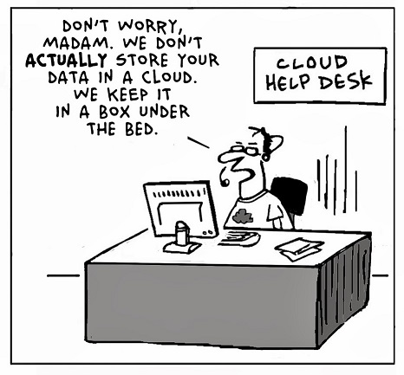
Cloud Security and Cost Concerns
Notes:
Cloud-based email was originally billed as a panacea for overworked (and often over budget) IT staff--an innovative new model that would relieve them from the burden of purchasing their own hardware, maintaining their own systems, and managing their own data. While many organizations choose to remain “on-premises” in regards to email for various reasons– many organizations are interested in making the move to the cloud if it make sense to them.
However, moving email to the cloud is never a simple proposition and many find they need help to successfully transition email to the cloud. Hidden “migration costs” can often quickly escalate without careful planning and professional help.
1

Slide 31
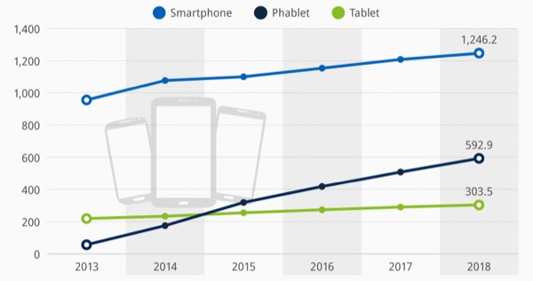
The Mobile Tidal Wave
88%
of employees report needing access to work documents from outside the office.
The number of global smartphone users is growing yearly by
42%
Global
Mobile
Device
Sales
Sources: IDC 2015; InfoWorld.com, “Mobile devices bring cloud storage—and security risks—to work,” June 2012; Forbes.com, “5 Eye-Opening Stats That Show The World Is Going Mobile,” December 2012;
Notes:
Mobility has introduced enormous change and challenges for IT, an nowhere are these more pressing than in email infrastructure. The vast majority of today’s information workers need access to work content outside the office. The number of smartphone users is growing by leaps and bounds (in fact, more iPhones are sold than babies are born each day). And tablet and phablet sales are seeing steady year-over-year growth too.
1

Slide 32
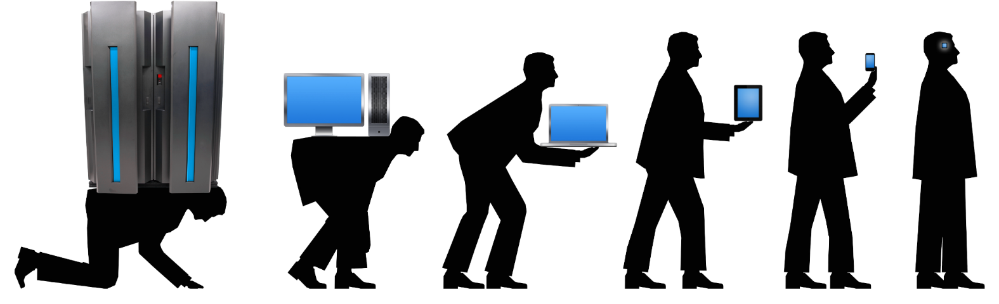
Right-Sized Collaboration and Tools
“In the long history of humankind (and animal kind too) those who learned to collaborate and improvise most effectively have prevailed.”
– Charles Darwin
Notes:
Finally, bigger isn’t always better when it comes to collaboration tools. Today’s organizations want right-sized applications that help them perform discrete tasks quickly and more effectively than ever before. Examples of this trend include:
Monolithic tools moving to small, mobile apps.
Rapid adoption of chat, real-time video communications, Instagramming, and highly agile applications that perform a specific task—and do it well.
An unwillingness on the part of users to bother with extraneous features, cumbersome UI, lengthy download times, or intervention from IT.
Enterprise Messaging addresses all of these trends with a secure and highly mobile on-premises solution that aids regulatory compliance by keeping IT in control—and one that keeps users productive with a right-sized collaboration experience.
1

Slide 33
Enterprise Messaging:
Ready for today’s world . . .

Slide 34








For End Users…
I want to be as productive as possible
  Easy signatures, reply options, quick addressing, easy filing, welcome page, options slide out, ability to duplicate any item type
I want choice and flexibility
  To access information on my mobile devices of choice, and the ability to make or change decisions about my emails, tasks and appointments on the fly
I want the latest look and feel
  Fresh look and feel (updated fonts, gradients and borders), flattened icons, monochromatic palette, elimination of visual clutter)
Desktop
Mobile
Email
Calendar
Social
Notes:
Enterprise Messaging meets the needs of key constituencies in today’s organizations. First is end users, who want:
To be as productive as possible
Choice and flexibility at the device and feature/function level
The latest look and feel and the confidence of using a contemporary interface
1

Slide 35
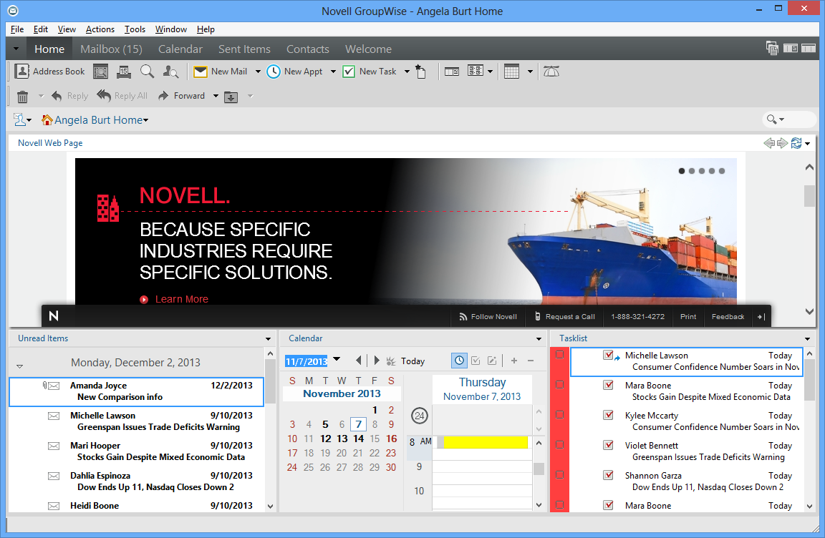
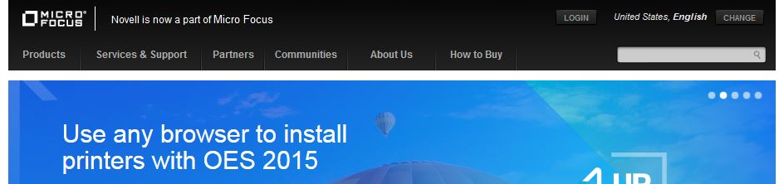
GroupWise Home View
Notes:
Home View Power – Get the most from your GroupWise client by learning and enabling the Home View. Did you know that you can have as many Home Folders as you want and that each one can be used to help you manage projects, teams, and activities? Instead of searching or navigating multiple locations to find the information you need, let GroupWise bring all of that information directly to you with a click of a button. Learn how queries, filters, display settings, and panels can be leveraged to completely change how you ‘Get things done!” Either simplify your end-users’ experience or supercharge it with the GroupWise Home View!
New for GroupWise 2014: Span columns
This Home view illustrates some of the other user interface improvements such as fewer user interface controls and constructs, flattened layout with no 3D borders or harsh dividers, removal of extra lines and unnecessary shading
1

Slide 36
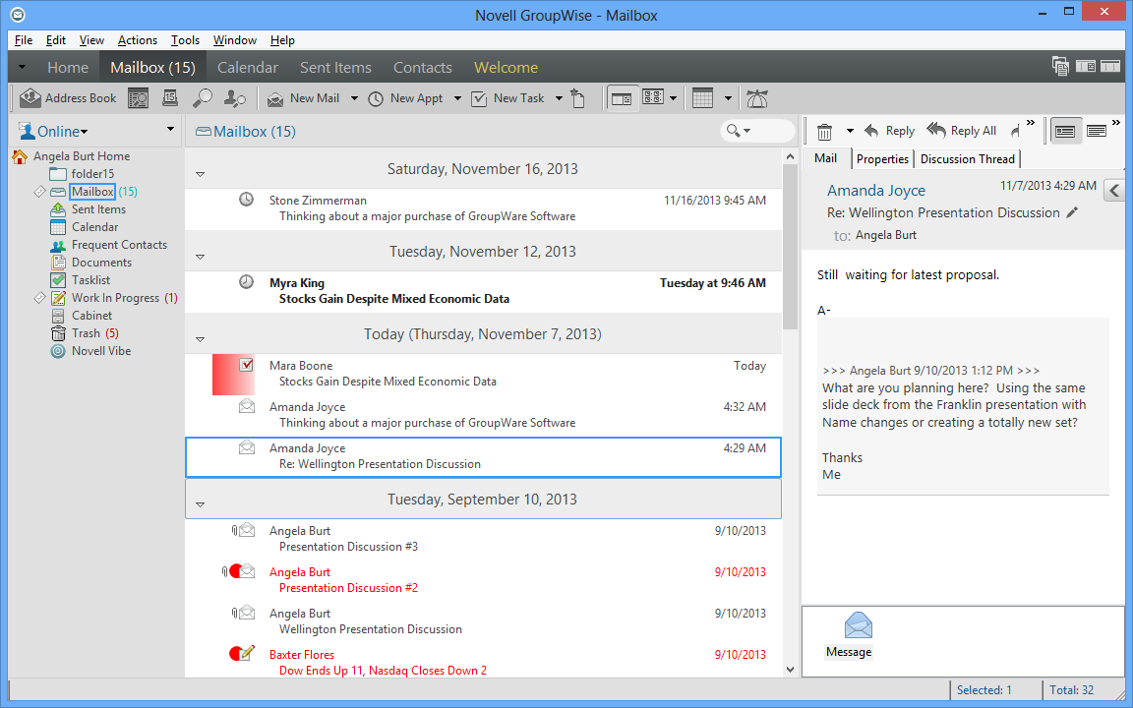
GroupWise Mailbox View
Notes:
Fresh and modern, but just as comfortable and familiar
New look and feel (color scheme, palette, borders, shading, gradients)
Design philosophy (darker colors on the outside, lighter on inside to draw your eye to the work at hand), fewer lines and borders, less visual clutter
Familiar layout, but more modern look. Similar to Microsoft Windows 8 and Apple iOS flat interfaces. Product fits better with other desktop, web, and mobile app interfaces that end-users are also installing and using
1

Slide 37



For IT…
I want administration to be easy
  Includes a new, streamlined web administration model, scriptable admin functions, advanced querying/reporting, and the ability to assign granular admin rights
I want choice and flexibility
    Works with both Active Directory and eDirectory, runs on multiple server and client platforms, and interoperates with Exchange, on-premises or cloud
I want the latest technology
  Leverages the latest hardware technologies (64-bit agent support), desktop operating systems, browsers and mobile devices
Directory
Platform
Desktop
Mobile
Notes:
For IT, GroupWise 2014 R2 offers:
Easy, web-based administration
Choice of directory, server and client platforms, and interoperability with other systems– as well as deployed on-premises or hosted in the cloud.
Support for the latest hardware, operating systems, browsers and mobile devices
1

Slide 38
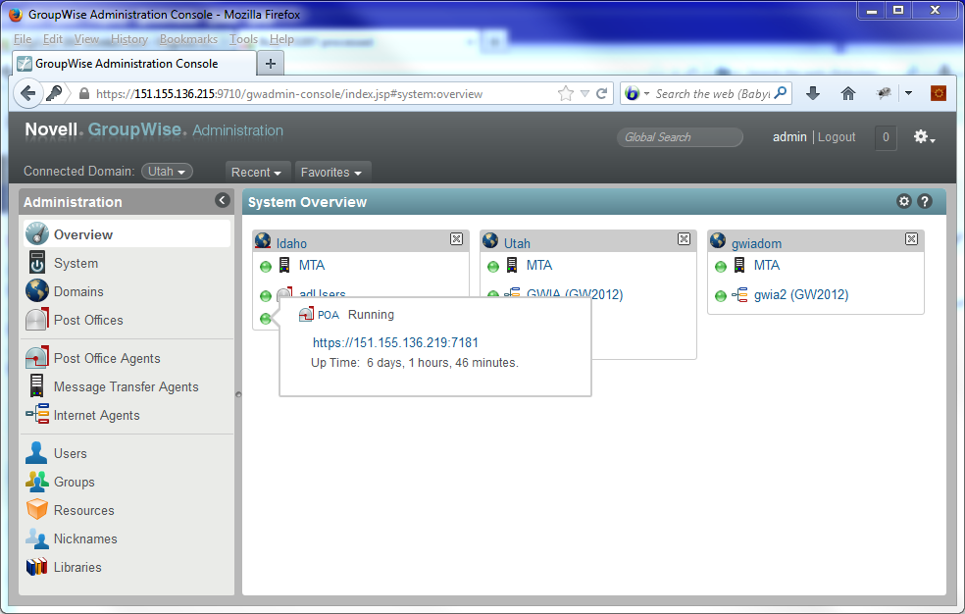
System Overview Page/Dashboard
Notes:
Much to the delight of administrators everywhere, we are replacing ConsoleOne® with a new web-based administration console. This enables you to administer your Micro Focus GroupWise system from anywhere you have access to a web browser and Internet connection. The new administration console has been redesigned and offers a streamlined user experience for configuring, maintaining, monitoring and troubleshooting your GroupWise system. Other administrative enhancements in GroupWise 2014 and GroupWise 2014 R2 include:
System Overview Page — The new system overview page offers a live view of all agents to show you what’s running and what’s not. You can also use it as a launching point to “http monitor” functionality. During upgrade, you can also easily tell which agents are upgraded and which ones are still running a previous version of the product. This is also a great place to review your entire GroupWise system and understand deployment progress or architectural decisions.
1

Slide 39
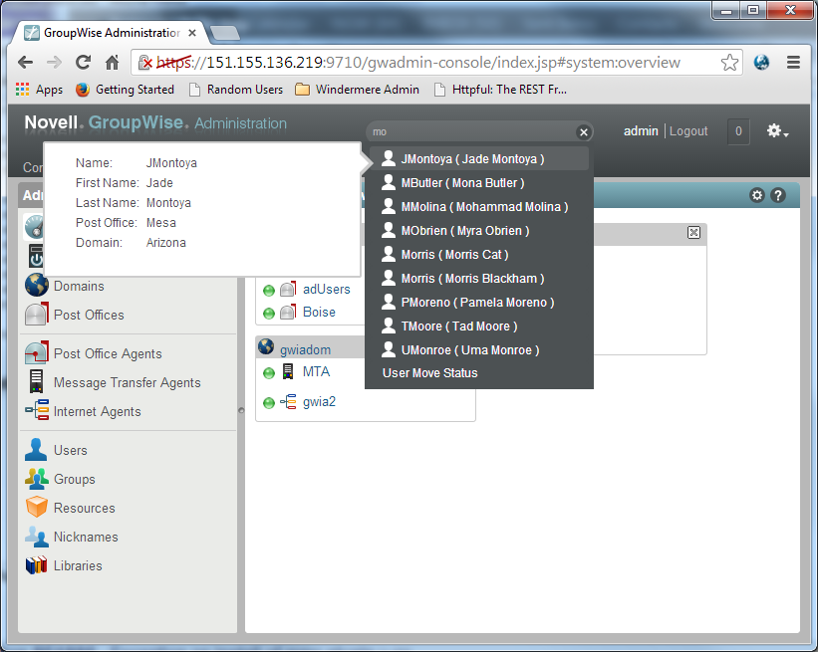
Global Search Function
Notes:
Search Functionality — The new global search function allows you to find just about anything in your GroupWise system by typing just a few characters. Find users (resources, groups, nicknames) by their account name, first or last name, email address, file ID (FID) or globally unique identifier (GUID). Look up domains or post offices by typing the first few characters of their name. Find POAs, MTAs and GWIAs by their IP addresses or by the name of the post office or domain they’re associated with. You can even find and launch system applets in the administration console itself by searching for them by name.
1

Slide 40












For Decision Makers…
I want to be as productive as possible
  Enhanced mobile support and features that make novices and power users alike more productive (without disrupting established work patterns)
I want choice and flexibility
  Low TCO and the ability to integrate with the other products in my environment and move to cloud
I want relevant technology that drives my business
  Support for the latest devices, platforms and technologies;
  worry-free security; the benefits of the cloud without the risks
Internal
External
Secure
Cost
Effective
IT Control
Desktop
Mobile
Notes:
Enterprise Messaging also accommodates enterprise decision makers, who want:
Productivity options that enhance productivity across all user types—without disrupting established work patterns
Choice and flexibility to maximize budget and leverage existing investments and move to the cloud
Relevant technology that drives business success and safeguards security and compliance
1

Slide 41
Why is evolving to
Enterprise Messaging
a smart choice?

Slide 42
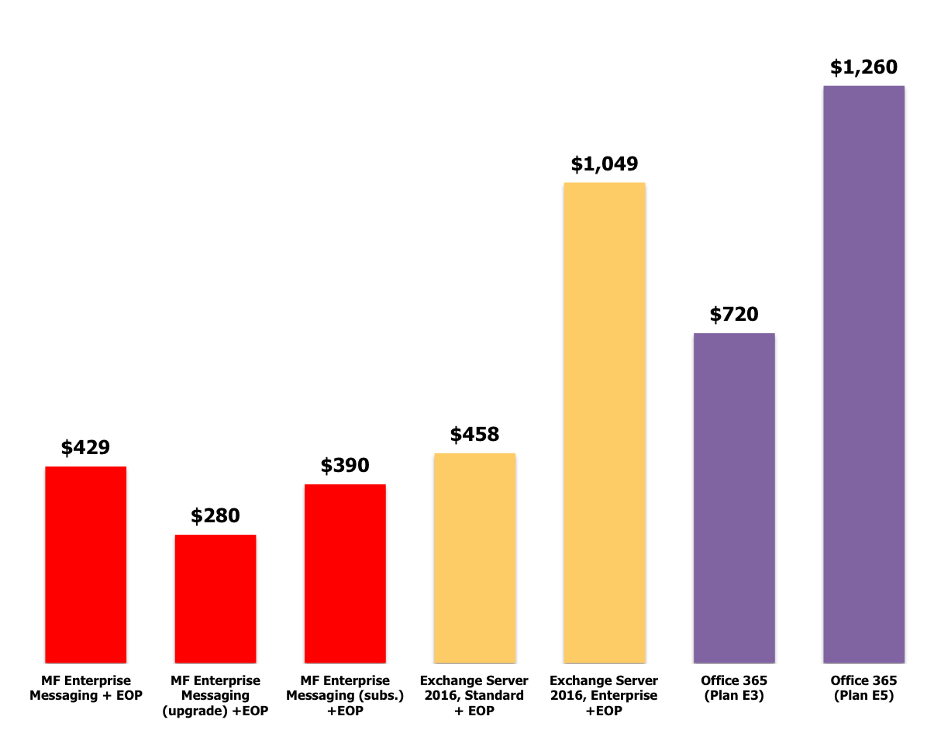
Enterprise Messaging:
Great features, low TCO
Source: Osterman Research, December 2017
Notes:
Enterprise Messaging has some of the lowest TCO costs on the market and– here’s some data from a research paper on the topic from Osterman Research. When it comes to comparisons between robust features and value– to costs– Enterprise Messaging excels.
1

Slide 43


GroupWise:
On-premises still beats Exchange
The three-year TCO of GroupWise is 52% lower than Microsoft Exchange
for an organization with 5,000 users.
Osterman’s three-year TCO figures for each product at the 5,000-user level are:
GroupWise: $1,796,188 (or $119.75 per user per year)
Exchange: $3,703,537 (or $246.90 per user per year)
Source: Osterman Research, January 2016
Notes:
Speaking of GroupWise’s low TCO– here’s some data from a research paper on the topic from Osterman Research about on-premises installations. It all boils down to cost– and the robust features offered by GroupWise really do offer great benefits for unbeatable TCO when it comes to your enterprise communication and collaboration needs.
1

Slide 44



Great Additional Benefits for GroupWise
Entitlements
Current GroupWise
Maintenance
Instant Messenger
Safe, secure corporate instant messages
GroupWise Mobility Service
Business email on mobile devices
Notes:
Also– there are additional benefits to using GroupWise. By being current on your GroupWise maintenance, you automatically get Instant Messenger for safe, secure corporate IM and GroupWise Mobility Service for compliant business email on mobile devices– all included at no extra charge.
1

Slide 45
The Collaboration Portfolio:
Individual Products
1
Notes:
We are excited to announce the all new product Enterprise Messaging!
1

Slide 46

GroupWise
It’s all about value and choice
Platform and Directory Agnostic
  Windows and Linux Servers
  Active Directory, eDirectory, Local Directory options
Benefits either on-premises or in the cloud
  Browser-based Administration
  Robust User Access
    Desktop (Win/Mac), Web, Mobile, Outlook
  Cloud-like costs, Lower TCO
    Security and no pricey add-ons
Coexistence Solutions
Notes:
(Existing Customer Script):
You already have GroupWise, capable of tackling your enterprise email & communication needs.
With GroupWise– it’s all about choice. We don’t force you into any specific platform because GroupWise is platform and directory agnostic. GroupWise runs on Windows and Linux servers, so you have a choice of what OS you have in your data center. Additionally– GroupWise also doesn’t force you into using any one directory. Active Directory, eDirectory, or even local directory options are all available.
GroupWise really is the best of both worlds– because you get many cloud-like benefits without the associated risks if you remain on-premises. You get the browser-based administration, robust user access on a variety of desktops, through the web, or on mobile devices. You even have choice of using Outlook or a GroupWise client on the front end, while still experiencing the lower TCO and cloud-like costs you’ve come to enjoy. You get top notch security without the risk of cloud and no pricey add-ons for additional functionality.
However– you can also enjoy all the same benefits with reduced hardware costs by having GroupWise run in the cloud too if you upgrade to Enterprise Messaging. GroupWise really is the best of both worlds!
Even better, GroupWise allows for co-existence with Microsoft Exchange– so if you’ve acquired a Microsoft shop or need to integrate with another organization who uses Microsoft Exchange– you can do so easily. You can have both Exchange and GroupWise running in your organization, saving you from costly migrations to any single platform.
1

Slide 47



GroupWise 18
The next version of GroupWise email
New Version “Reset”
  Resets Product Lifecycle
  5 more years of support
Integrated GroupWise
Messenger Administration
Deeper Filr Integration
No Cost Upgrade
  Must be current on maintenance
Social Threading
  All replies to email roll up under the original message rather than coming
  in as new messages
Arriving December
2017
Notes:
1

Slide 48
Micro Focus Secure Messaging Gateway
Safeguarding GroupWise
Total GroupWise Protection
  It is the only solution that scans the MTA and POA
  Protects GroupWise Web Access
  GroupWise Mobility Service protection
Unparalleled protection
  Inbound and outbound protection, antivirus, anti-spam, cybercrime protection
Image Analyzer
  Monitor & Block Illicit & Pornographic Images & Videos
DoS/DDoS Protection
  Protection from attacks to the SMTP
Antivirus Protection
  Zero-hour antivirus protection available for both inbound and outbound traffic
Anti-Spam Protection
  Multi-layer spam defense to protect email and keep unwanted traffic away from your collaboration system
Notes:
1

Slide 49
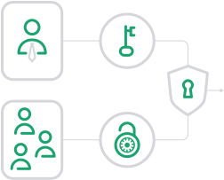

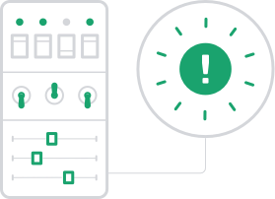


GWAVA 7 is now Secure Messaging Gateway!
Complete antivirus protection
Multi-layer spam defense
Multi-system support
On-prem or cloud
Total GroupWise Support
GroupWise
1
Notes:
GWAVA 7 renamed to Micro Focus Secure Messaging Gateway
GroupWise WebAccess scanning (WASP) is going to be part of SMG.
MTA, POA, WebAccess and GMS scanning will be available for GroupWise 18
1

Slide 50
Reload: GroupWise Disaster Recovery
Ensuring the continuity of GroupWise
Auto-Reload
  End users can restore messages to the live inbox without assistance from IT
Push Button Disaster Recovery
  Push a button (click)
  Switch the DNS A record for the Post Office or Domain
GroupWise SmartPurge Integration
  All items are backed up
  Items cannot be purged until they are backed up
  Nothing can be purged from the backup
Disaster Recovery & Backup for GroupWise
  Hot Backups
  Immediate Recovery & Full Restoration
GroupWise Failover
  Can serve as your GroupWise system, if GroupWise goes down
  Ensure that GroupWise is always up and running
Restore in minutes
  Single messages
  Multiple messages
  Address books
  Entire mailboxes
Notes:
1

Slide 51

Redline: GroupWise Reporting & Monitoring
Comprehensive & customizable monitoring & reporting
Reports and dashboards provide a quick health check of GroupWise and other third party products
  1000+ data points
  Current status reports
  Trending reports
  Compliance and audit reports
  120 Customizable reports
  Report scheduling
  Quick status dashboard “GroupWise at-a-Glance”
Administer all monitored components from a single interface
  GroupWise, Secure Messaging Gateway, Retain, and other third party products
GroupWise at a Glance Dashboard
  Alert indicators - Ties into the monitoring infrastructure
  Performance indicators - Shows key information about GroupWise
  Graphs and gauges - Displays message traffic and connected users
Notes:
1

Slide 52

Vertigo: GroupWise Mailbox Management
Enterprise Mailbox Management for GroupWise
Mailbox management from a single administrative tool
  Proxy Management
  Rules Management
  Folder Management
  System Management
  Address Book Management
  Signature Management
  Environment Settings
  Junk Mail Handling
  Reporting
Proxy Management
  Enable, disable and delete rules
  Ensure policy enforcement
Folder Management
  See folder hierarchies
  Copy folder structures
  Report on folder information
  Eliminate unnecessary folders
System Management
  Complete overview of all users
  FID, Expiration Date, Disables Logins, Visibility, Domain and PO properties
  Print and export
Notes:
1

Slide 53





Micro Focus Vibe®
Next Generation Collaboration Platform
Document Management
Project Collaboration
Collaborative Intranets
Knowledge Repository
Process Automation
Versioning, sharing, approval, lifecycle, search
Tasks, calendars, security, one place, awareness, retention, internal/external users, apps and processes, templates/reuse
Collaborative, user control and contribution, flexible, branding, awareness, social
Depth: wiki, blog, discussion, files, tasks, calendars, images, custom forms, 400+ file types
Advanced and simple workflows, custom forms
M O B I L E A C C E S S
Notes:
1

Slide 54
Making GroupWise Even Better:
Looking Forward
Notes:
But what’s Micro Focus’s commitment to GroupWise? Well– let’s share that with you by explaining our vision for GroupWise, a looking forward Roadmap, along with how we want you to help us improve and enhance the product itself. Simply put– Micro Focus is committed to GroupWise!
1

Slide 55



Collaboration Vision and Strategy
What’s Micro Focus’s Direction?
Vision
Objective
Strategy
Provide unified instant & persistent exchange of messages, including relevant files and communication history to enhance team collaboration.
Increase customer retention by defining, communicating and implementing a relevant unified team collaboration story for the portfolio.
Enhance team collaboration and social business features to “blur the lines” between instant & persistent team collaboration
Simplify pricing and packaging
Build community and include them in product priorities
Work with key ISV partners for complete solution offerings
Notes:
Vision
Provide unified instant & persistent exchange of messages, including relevant files and communication history to enhance team collaboration
Strategic Objective
Increase customer retention by defining, communicating and implementing a relevant unified team collaboration story for the portfolio
Strategy
Focus on enhancing team collaboration and Social Business features to “blur the lines” between instant & persistent team collaboration
Simplify the pricing and packaging
Bring GroupWise Mobility Services & Messenger into a common versioning, administration and user provisioning implementation
Build customer and partner communities and include them in definition of priorities
Ideas Portal
https://ideas.microfocus.com/MFI/Novell-gw
https://ideas.microfocus.com/MFI/Novell-vibe
Collaboration Community Webinars
https://ideas.microfocus.com/MFI/novell-collabctw
Strengthen relationships with key ISV partners for complete solution offerings
1

Slide 56



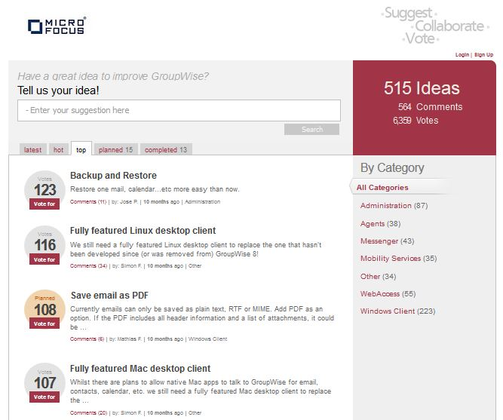
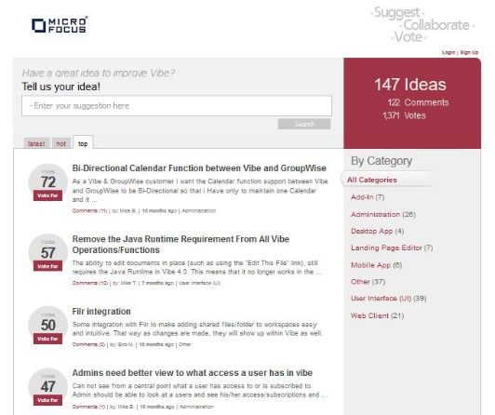
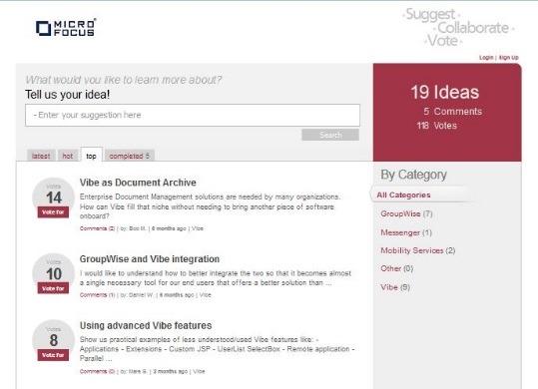
Idea Portals
Community-driven Requests and Requirements
GroupWise
Vibe
Webinars
https://ideas.microfocus.com/MFI/mfl-gw
https://ideas.microfocus.com/MFI/mfl-vibe
https://ideas.microfocus.com/MFI/mf-collabctw
Notes:
Engage with us - Multiple ways to participate
https://ideas.microfocus.com/MFI/mf-gw
https://ideas.microfocus.com/MFI/mf-vibe
https://ideas.microfocus.com/MFI/mf-collabctw
Stats
6 community driven webinars delivered
More planned – Monthly
GroupWise
847 Ideas
11,000+ Votes
33 Completed by release up to release of GroupWise 18
10 more planned in Enterprise Messaging/GroupWise 18 & more coming
1

Slide 57
Collaboration Roadmap
Shipping
Committed
Planned
New and Upcoming Releases
1H 2017
2H 2017
1H 2018
GroupWise 2014 R2 SP2
GroupWise 18 “Wasatch”
GroupWise “Traverse”
Enterprise Social Collaboration
Improved TCO
IDEA Enhancements
Improved Calendar function on mobile
IDEAS Enhancements
Quality Improvements
Mobile Vacation Rules
Improved TCO
Quality Improvements
Security Updates
Mobile Vacation Rules
Quality Improvements
Security Updates
Improved Administration experience
Enterprise Social Collaboration
Enterprise Security
Improved TCO
IDEAS Enhancements
GroupWise Mobility Service 18
Mobility Service 2014 R2 SP2
Enterprise Messaging
GroupWise TeamWorks “Uinta”
GroupWise TeamWorks “Pinnacle”
Enterprise Social Collaboration
Dedicated Team/Project Rooms
GroupWise, Web, Mobile Access
Improved Administration experience
IDEAS Enhancements
Enhanced Presence
Vibe 4.0.3
Vibe 4.0.4
Vibe 4.0.5
Quality Improvements
Security Updates
Quality Improvements
Security Updates
Quality Improvements
Security Updates
Notes:
<номер>

Slide 58
Secure Messaging Gateway Roadmap
New and Upcoming Releases
1H 2017
2H 2017
1H 2018
GWAVA 7
Micro Focus Secure Messaging Gateway
Micro Focus Secure Messaging Gateway*
Scanning support for additional file types
Message Tracker
Monthly Updates (Patch Thursday)
Policy Updates
Quality Improvements
Migration Tool from GWAVA 6.x to 7
Complete GroupWise Integration
Micro Focus Branding
Monthly Updates (Patch Thursday)
Policy Updates
Quality Improvements
Improve SaaS Offering
Additional Micro Focus Product Integration
DKIM Support
Message Inspection
End-to-end Encryption
GWAVA 6.x
Quality Improvements
Definition Updates
Shipping
Committed
Planned
Notes:
<номер>

Slide 59
Customers like you
who’ve chosen Micro Focus

Slide 60

Vinzenz von Paul Kliniken
Critical Disaster Recovery and Archiving for GroupWise
Problem:
Solution:
Results:
Large GroupWise email store was causing long and cumbersome back-ups. Needed a way to reduce the time of back-ups, provide easy restore, and archving.
Found GroupWise Disaster Recovery and Retain was perfect for GroupWise
Significantly reduced back-up times, while offering new fail-over capabilities and a complete and robust archive of email communications.
Their Advice:
Micro Focus fits perfectly in our environment and the license structure makes it a cost effective solution with many added benefits.
https://www.microfocus.com/media/success-story/vinzenz_von_paul_kliniken_ggmbh_ss.pdf
Notes:
<номер>

Slide 61

Millikin University
Competitive Win Against Free Cloud Alternatives
Problem:
Solution:
Results:
“Free”, cloud-based email seemed too compelling to ignore.
Crunched the numbers and found that “free isn’t necessarily free”.
Upgraded their GroupWise and saved $35,000 in hard migration costs (not to mention the expense of end-user training, consulting and rewriting business processes).
Their Advice:
It pays to do the math.
https://www.microfocus.com/success/stories/millikin-university/
Notes:
<номер>

Slide 62

Mukwonago School District
Three-product Competitive Win Back
Problem:
Solution:
Results:
A move from GroupWise to Zimbra led to a unacceptably high support costs and up to 10 outages per month.
Returned to Novell GroupWise, Novell ZENworks and Novell Open Enterprise Server. Added Novell Filr, Novell iPrint Mobile, and ZENworks Mobile Management.
Reduced external support costs by 42% and returned network outages from 10 per month to 0.
Their Advice:
GroupWise gives higher levels of security and a feature set not available with other solutions.
https://www.microfocus.com/success/stories/mukwonago-area-school-district/
Notes:
<номер>

Slide 63
Conclusion
Notes:
<номер>

Slide 64

Key Takeaways
Enterprise Messaging is relevant to today’s market challenges and important to Micro Focus
It does not have to be one or the other,
Enterprise Messaging has key coexistence solutions and can be on-premises or hosted in the cloud.
Enterprise Messaging fully supports multiple desktop platforms and mobile platforms.
Micro Focus partners have solutions that solve critical business problems
Both Enterprise Messaging and GroupWise have low TCO for great features and benefits.
Notes:
<номер>

Slide 65
Thank you!
1

Slide 66
www.microfocus.com
Notes:
<номер>

Slide 67
Forward-Looking Statements
This document contains forward looking statements regarding future operations, product development, product capabilities and availability dates. This information is subject to substantial uncertainties and is subject to change at any time without prior notification. Statements contained in this document concerning these matters only reflect Micro Focus International and its affiliates’ (collectively, “Micro Focus’s”) predictions and / or expectations as of the date of this document and actual results and future plans of Micro Focus may differ significantly as a result of, among other things, changes in product strategy resulting from technological, internal corporate, market and other changes. This is not a commitment to deliver any material, code or functionality and should not be relied upon in making purchasing decisions.
1

Slide 68
Micro Focus Confidential Information
Regarding roadmaps and other information
This roadmap contains Confidential Information of Micro Focus and its affiliates (collectively, “Micro Focus”).
If you have a valid Confidential Disclosure Agreement with Micro Focus, disclosure of the roadmap is subject to that CDA. If not, you may not view these materials or use them for any purpose, and you must delete any copies in your possession.
1

